Slide 1
Lecture # 7C
20 October 2020
Dr. A. Upadhyaya TA201: Introduction to Manufacturing Processes

Slide 2
Effect of Temperature on Deformation
Dr. A. Upadhyaya TA201: Introduction to Manufacturing Processes

Slide 3
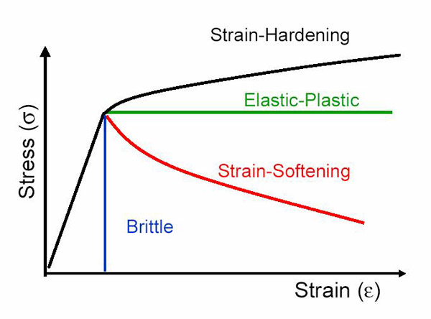

Slide 4
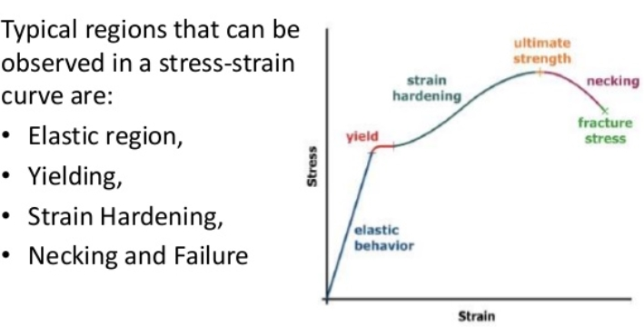

Slide 5
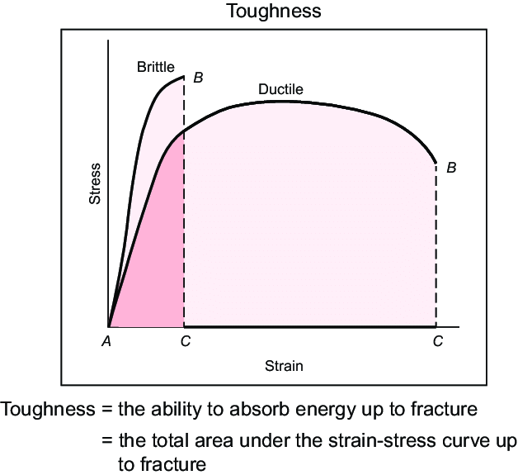

Slide 6
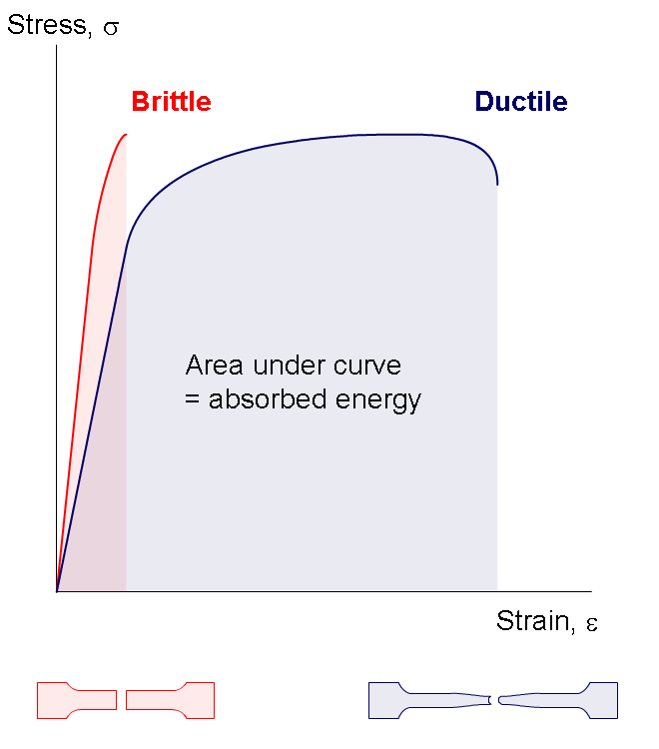

Slide 8
Temperature in Metal Forming
Any deformation operation can be accomplished with lower forces and power at elevated temperature
Three temperature ranges in metal forming:
  - Cold working
  - Warm working
  - Hot working

Slide 9
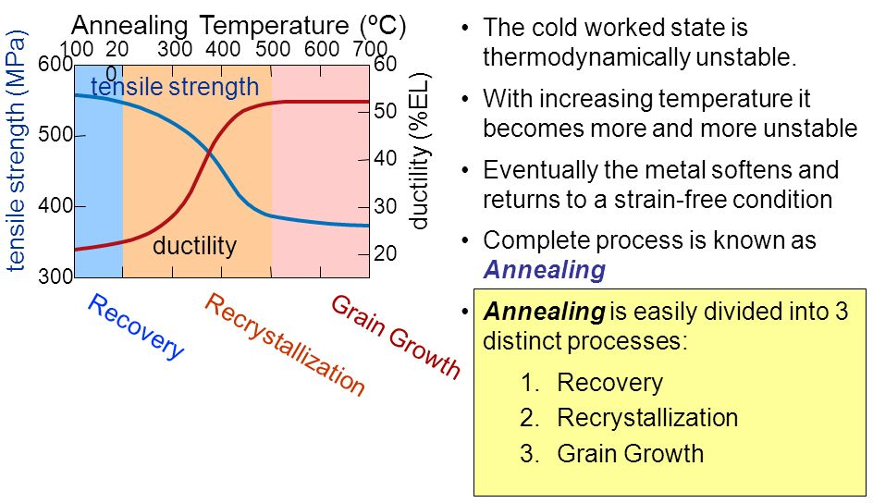

Slide 10
Three Stages of Annealing:
Recovery
Recrystallization
Grain Growth
Recrystallization Temperature: Typically > 0.5T_{m}
(T_{m} is melting point of alloy in Kelvin)

Slide 11
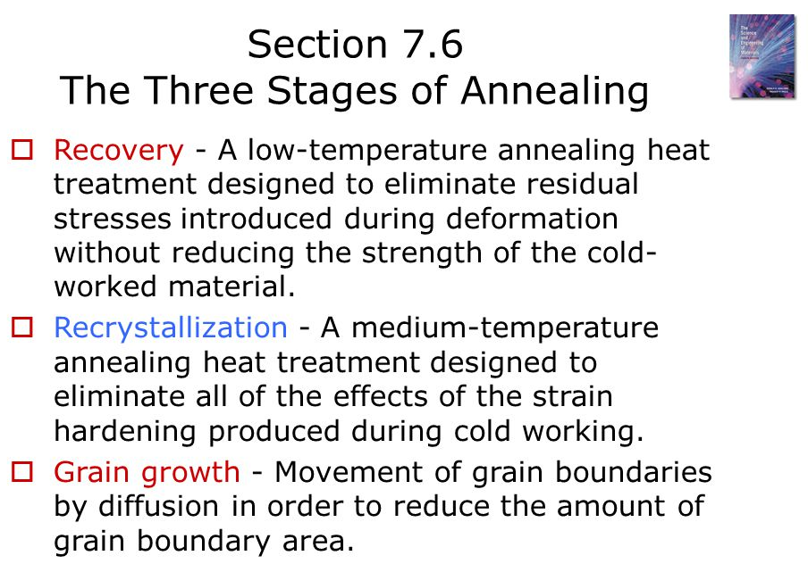

Slide 12
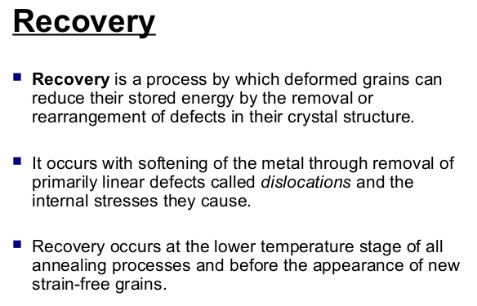

Slide 13
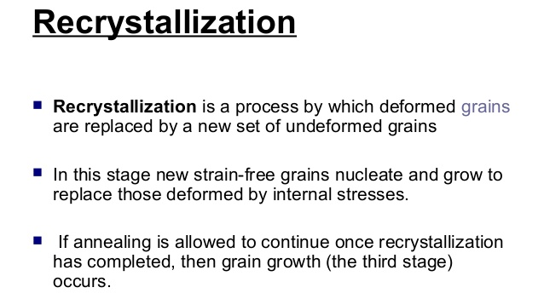

Slide 14
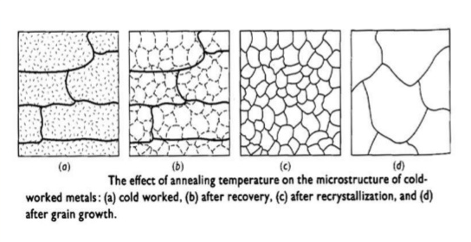
Changes in Microstructure of a Coldworked Metal
during Different Stages of Annealing

Slide 15
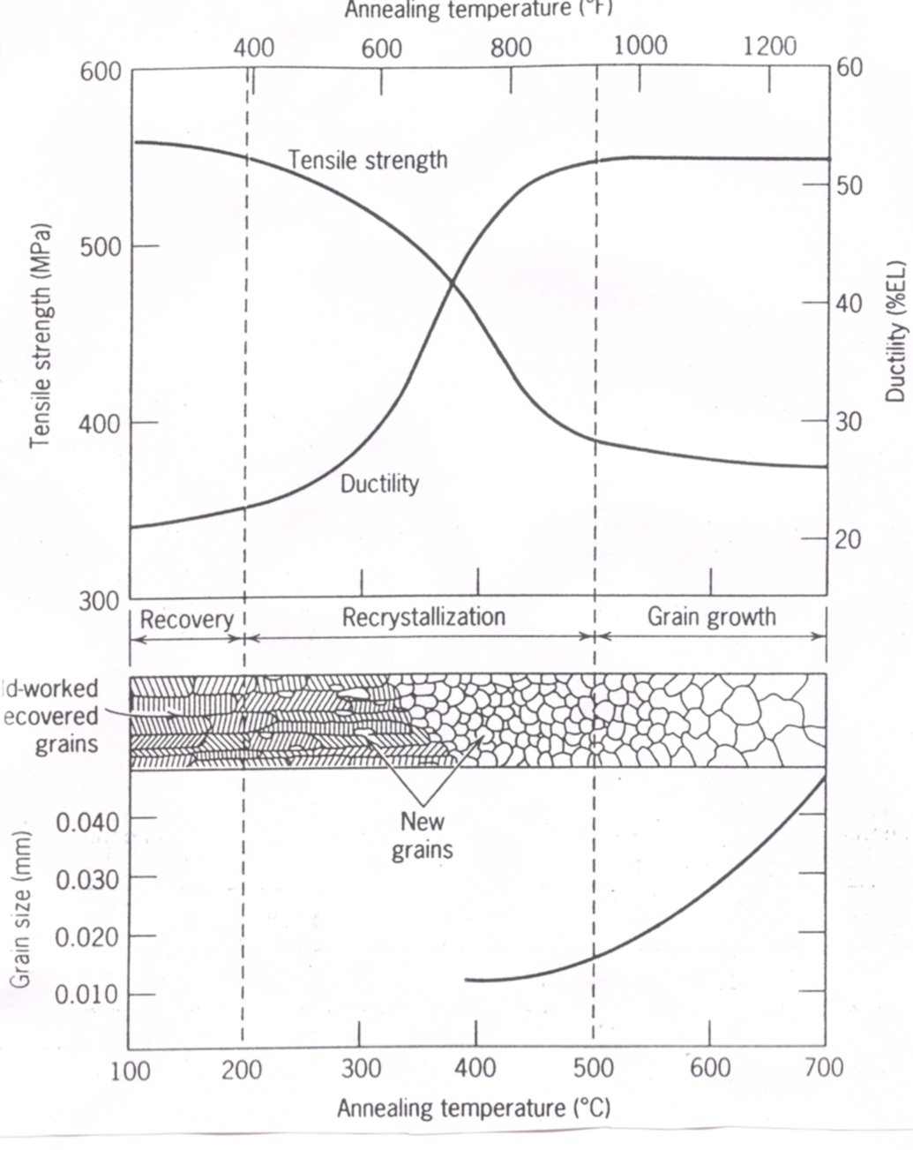
Influence of Annealing Temperature on the
Tensile Strength and Ductility of a Brass Alloy

Slide 16
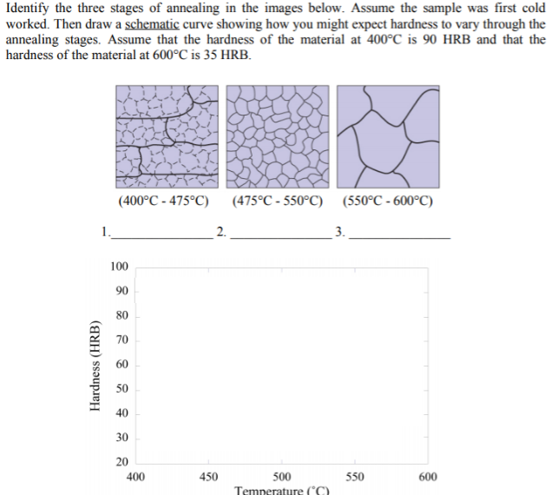

Slide 17
Disadvantages of Cold Forming
Higher forces and power required
Surfaces of starting workpiece must be free of scale and dirt
Ductility and strain hardening limit the amount of forming that can be done
  In some operations, metal must be annealed to allow further deformation
  In other cases, metal is simply not ductile enough to be cold worked

Slide 18
Hot Working
Deformation at temperatures above recrystallization temperature
Recrystallization temperature = about one‑half of melting point on absolute scale
  In practice, hot working usually performed somewhat above 0.5T_{m}
  Metal continues to soften as temperature increases above 0.5T_{m}, enhancing advantage of hot working above this level

Slide 19
Why Hot Working?
Capability for substantial plastic deformation of the metal ‑ far more than possible with cold working or warm working
Why?
  - Strength coefficient is substantially less than at
  room temperature
  - Strain hardening exponent is zero (theoretically)
  - Ductility is significantly increased

Slide 20
Advantages of Hot Working vs. Cold Working
Workpart shape can be significantly altered
Lower forces and power required
Metals that usually fracture in cold working can be hot formed
Strength properties of product are generally isotropic
No strengthening of part occurs from work hardening
  - Advantageous in cases when part is to be subsequently processed by cold forming

Slide 21
Advantages of Cold Forming vs.
Hot Working
Better accuracy, closer tolerances
Better surface finish
Strain hardening increases strength and hardness
Grain flow during deformation can cause desirable directional properties in product
No heating of work required

